Slide 1
AAA_I2025_Auto Encoding Neural Process for Multi-interest Recommendation
Auto Encoding Neural Process for Multi-interest Recommendation
（AAAI-2025 Code — https://anonymous.4open.science/r/NP-Rec-CF45)
Reported by Jiale Shen

Slide 2
motivation
1.Multi-interest recommendation constantly aspires to an oracle individual preference modeling approach, one that satisfies the diverse and dynamic properties.
2.However, as the parameterized approximate function nature,NN-based methods remain deficiencies regarding the adaptability towards distinctive preference patterns cross different users, and the calibration over individual current intents.

Slide 3
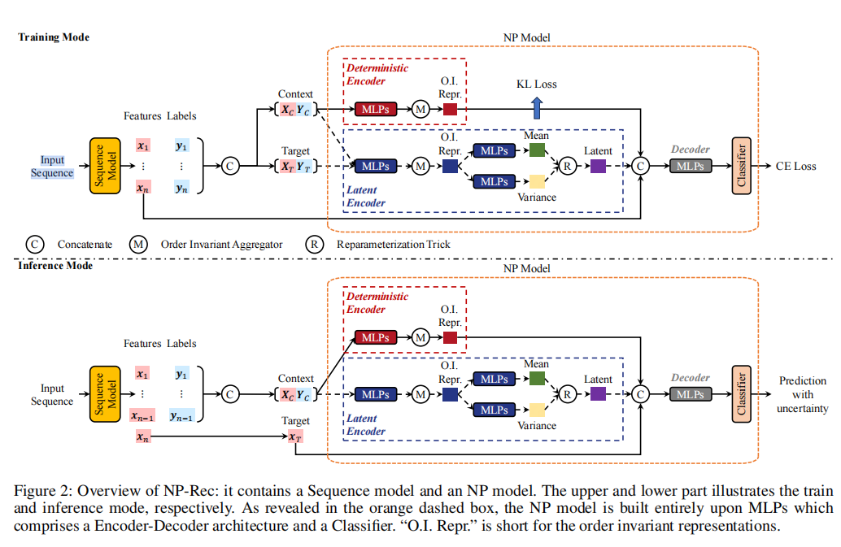
Overview

Slide 4
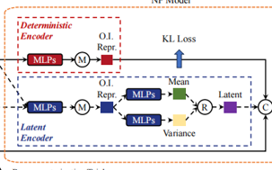
Approach

Slide 5
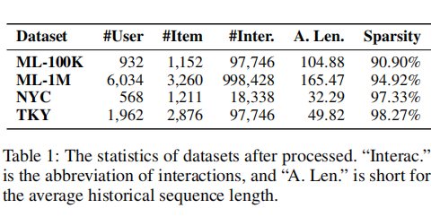
Experiment

Slide 6
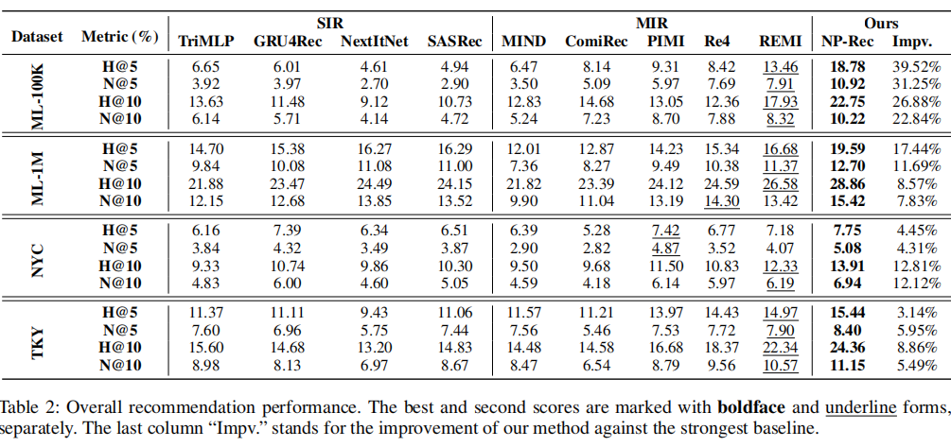
Experiment

Slide 7
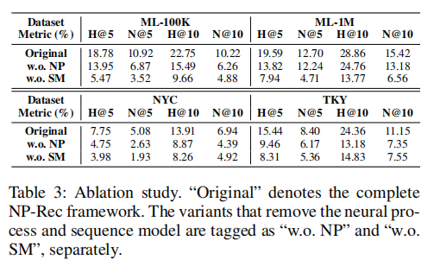
Experiment

Slide 8
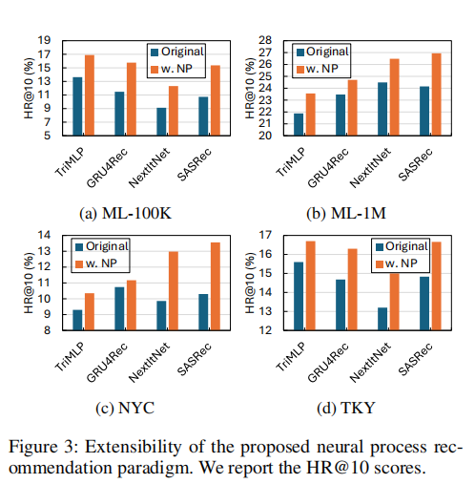
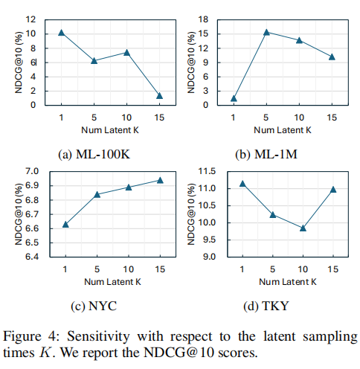
Experiment

Slide 9
Thank you!

Slide 10
